Slide 1
Regulatory and Statutory Reporting Project
As-Built Design

Slide 2
Change/Deviation Summary
System Interfaces | : | Change/Deviation: The current setup requires users to access the application through Remote Desktop and run the application directly on the Application Server. Due to limitations in this setup, multiple users cannot run the application simultaneously. Rationale/Justification: To address this limitation, the application folder on the Application Server has been configured as a shared folder and made accessible to authorized users. Users will run the application from their local workstations using the shared application files instead of running it directly on the Application Server. This change enables multiple users to use the application simultaneously, improves accessibility, and reduces dependency on Remote Desktop sessions.

Slide 3
Project Details
Project Name | : | Regulatory and Statutory Reporting Project
Date Requested | : | November 2024 | ARB Date | : | September 26, 2025
Project Start Date | : | October 2, 2025 (Tentative) | Target End Date | : | July 6, 2026 - Phase 1 TBD - Phase 2
Business Units Affected | : | MRRD from EWB UNI and FRCT from EWB RB
Key Stakeholders | : | MRRD from EWB UNI and FRCT from EWB RB
Contributors / Work Groups | : | MRRD, FRCT, Process and System Support, ITG
Feasibility Assessment | : | The software introduction and overview was conducted in November 2024 while the Proof of Concept (POC), which was spearheaded by MRRD under Ms. Editha Abunan, were concluded last February and August 2025.
Scope and Business Objectives | : | Solution to the regulatory and statutory reports required by the Bangko Sentral ng Pilipinas (BSP). The package will include the following modules: Validation XML Conversion XRM (submission to BSP)

Slide 4

Design Considerations
Design Approach | : | On-premise, two-tier architecture with terminal server that the user connects to using RDS
Design Alternatives | : | Solution Options: SoftApp FPTI (NOAH) G2 Risk Solutions (FinTellix)
Constraints and Limitations | : | The web application version is not available.
Dependencies | : | Regular checking of updates from BSP, which may result in changes to the format and validation.
Compliance | : | This project is driven by the following: Regulatory compliance to Section 172 of the MORB dated December 2022. MEMORANDUM NO. M-2023-004 MEMORANDUM NO. M-2021-052
Risks | : | Regulatory team will continue their manual process, which takes time and is prone to errors.
Existing Defects Resolved | : | Penalization for resubmission, the amount enumerated in the MORB are as follows:

Slide 5
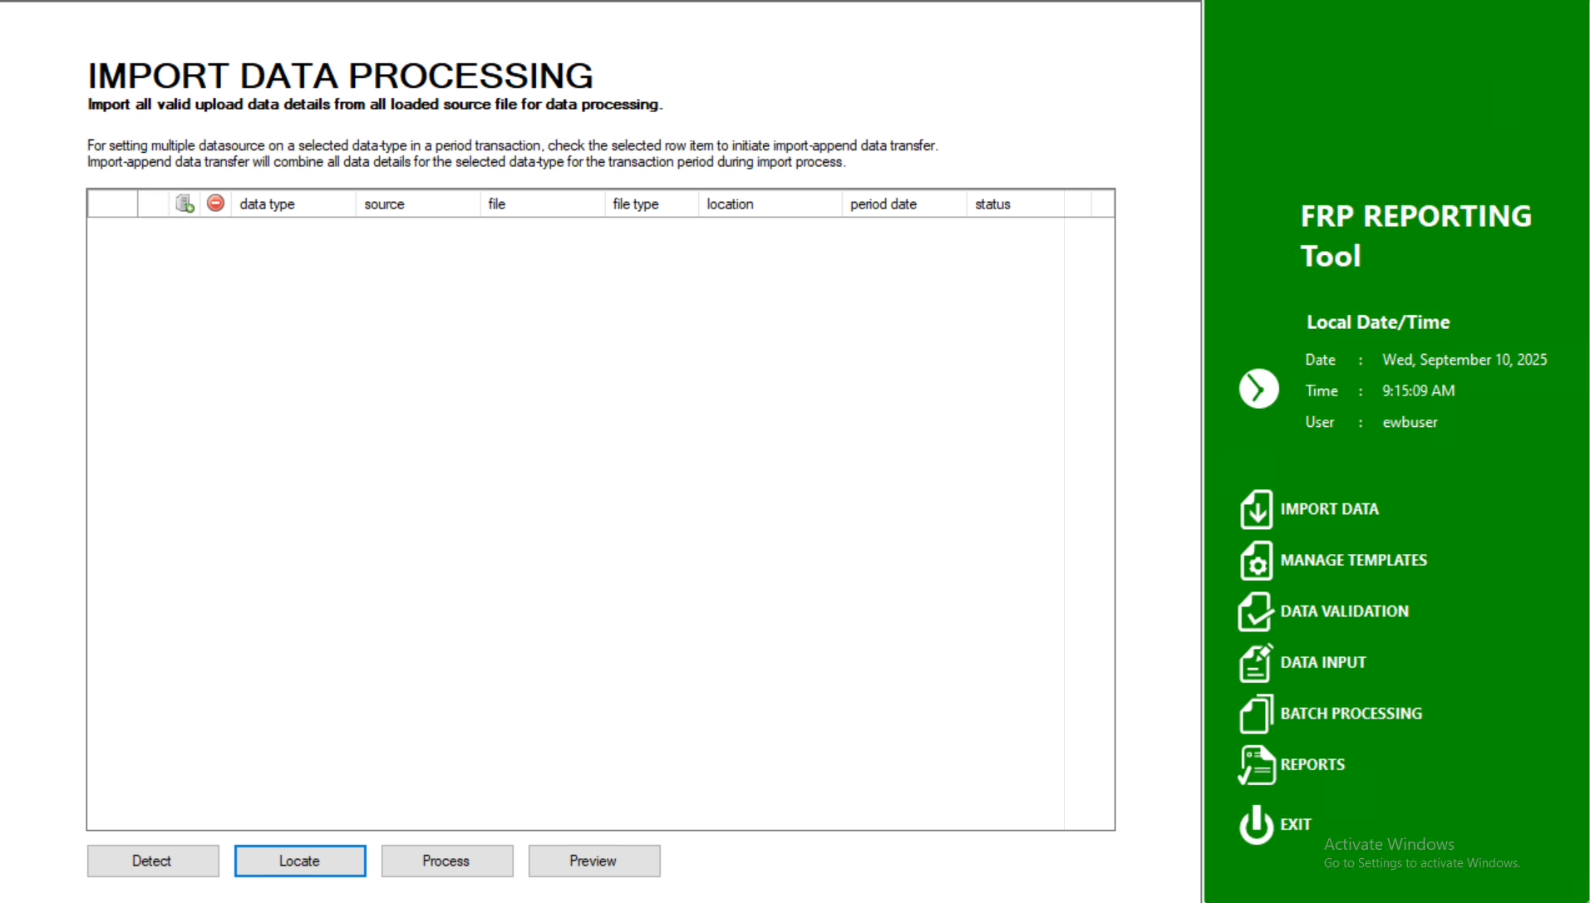
User Interfaces, Usability and Accessibility (1/5)

Slide 6
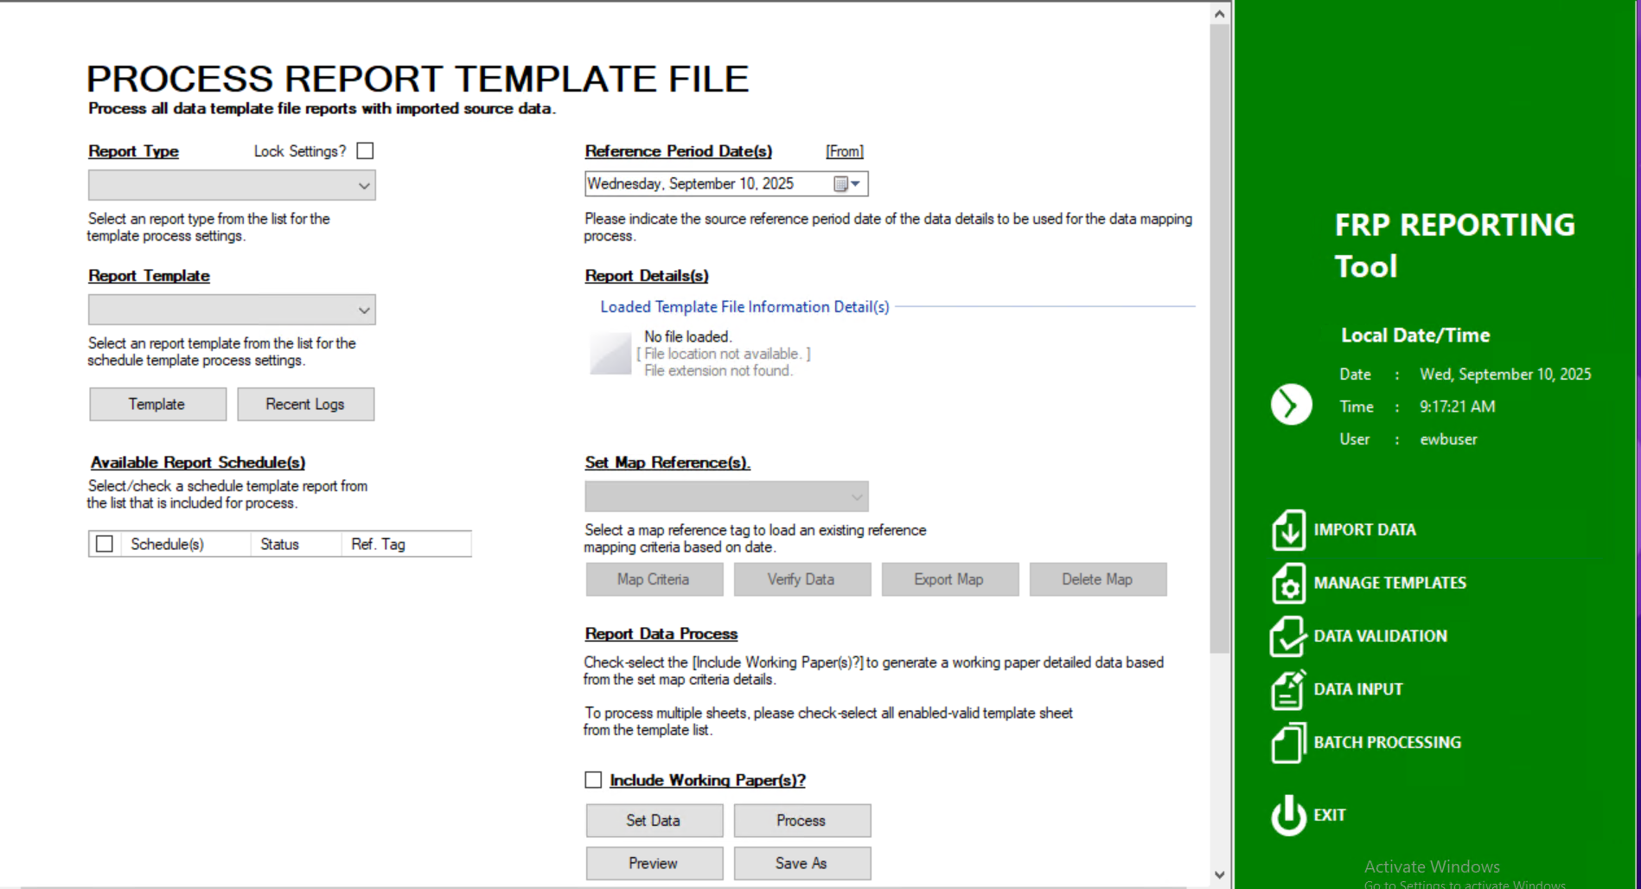
User Interfaces, Usability and Accessibility (2/5)

Slide 7
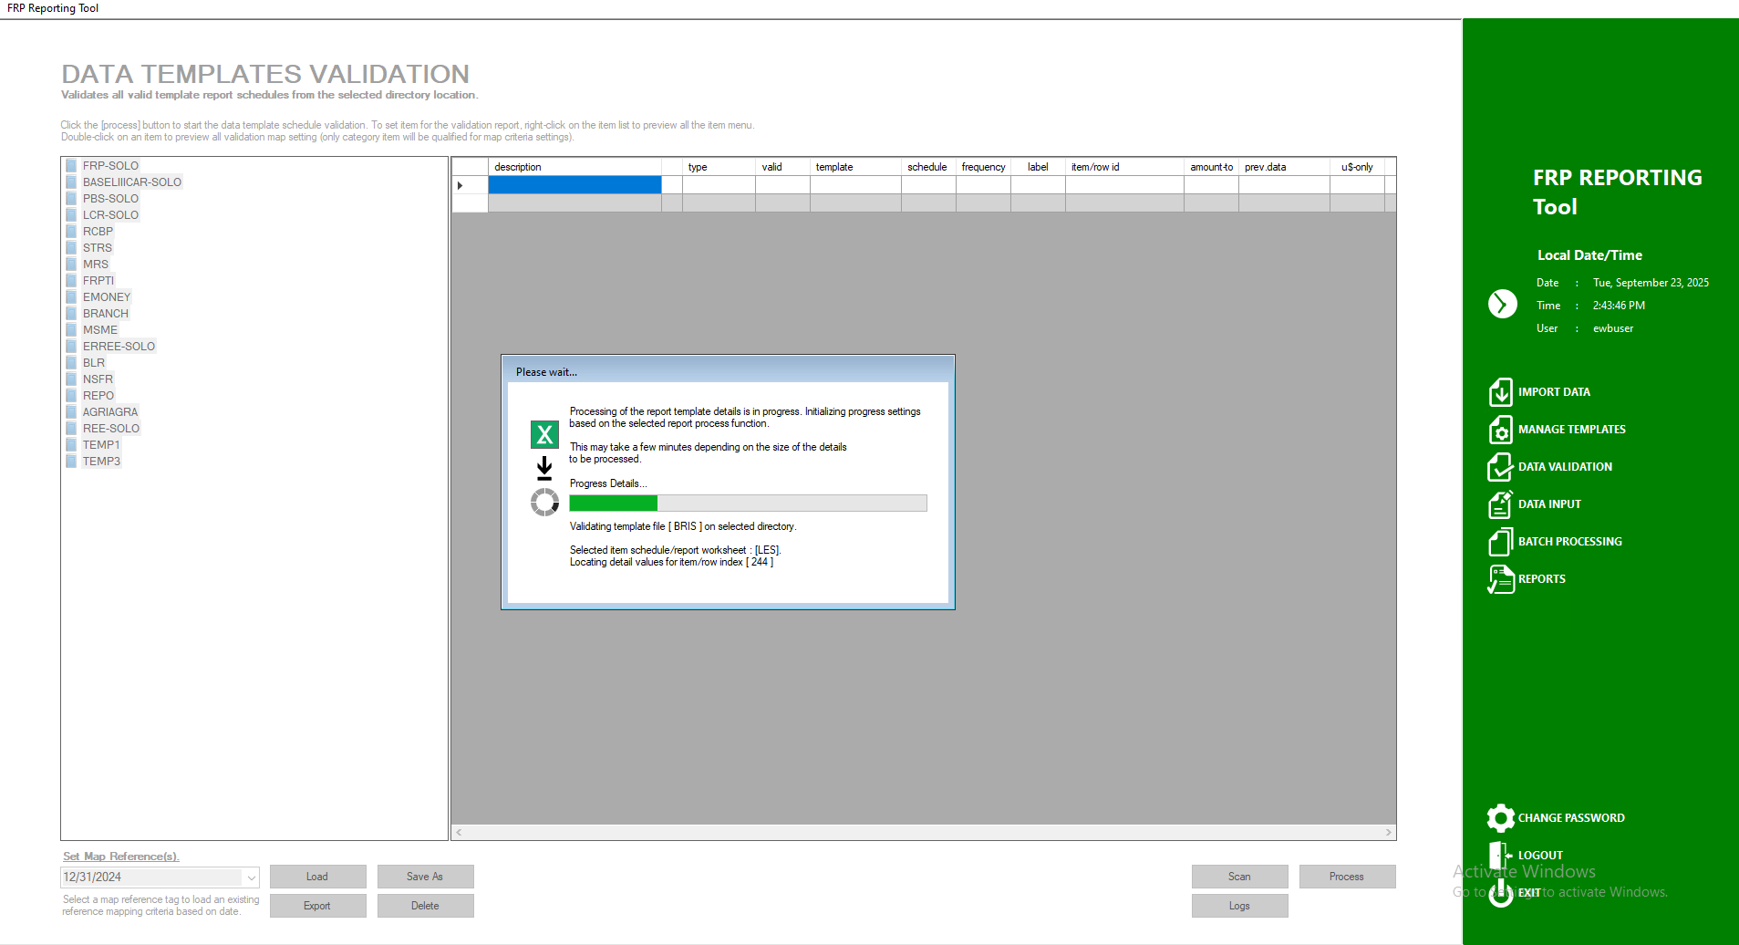
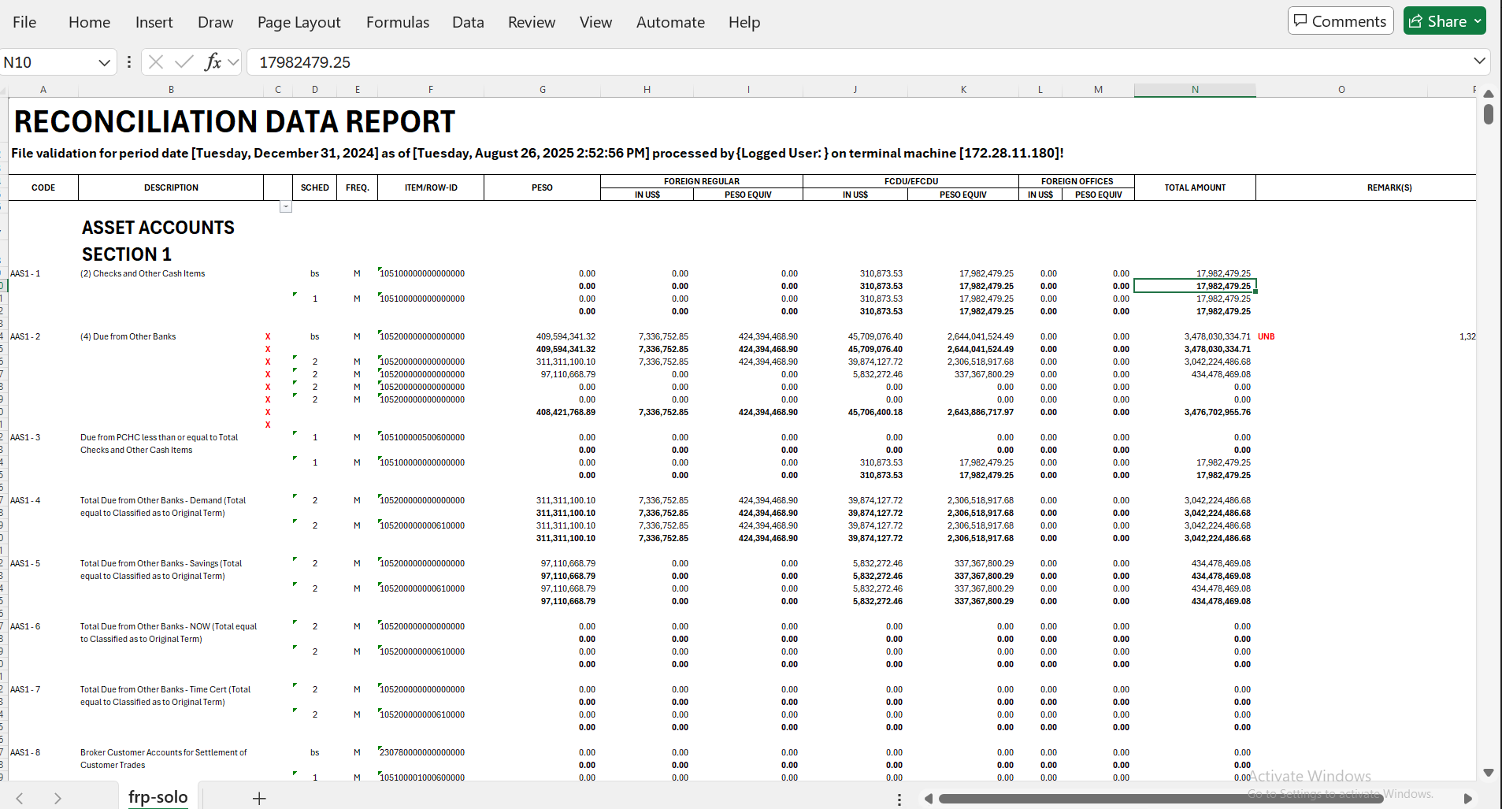
User Interfaces, Usability and Accessibility (3/5)

Slide 8
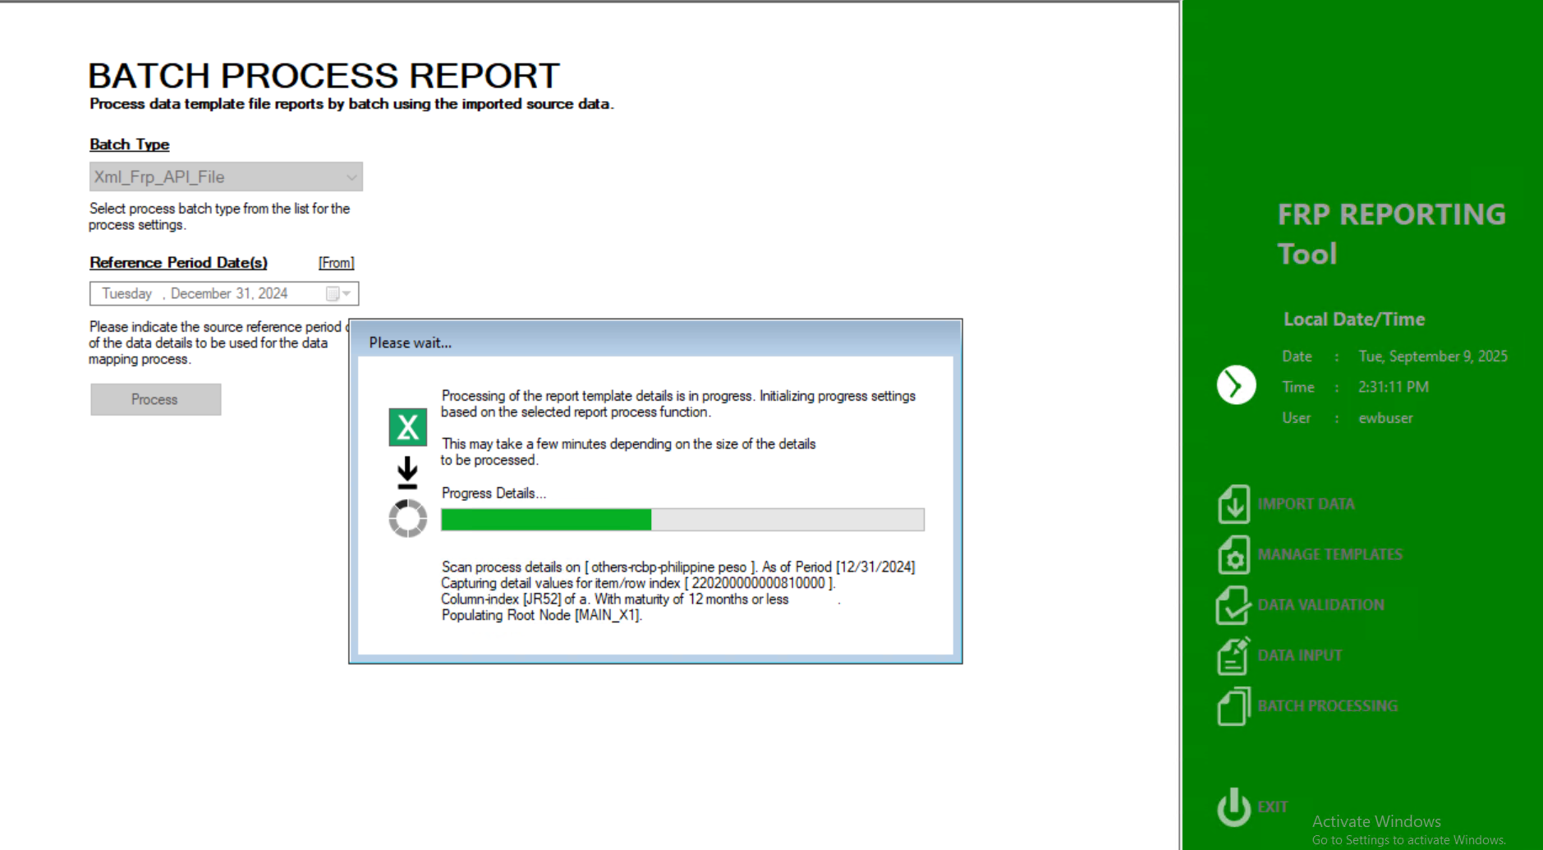
User Interfaces, Usability and Accessibility (4/5)

Slide 9
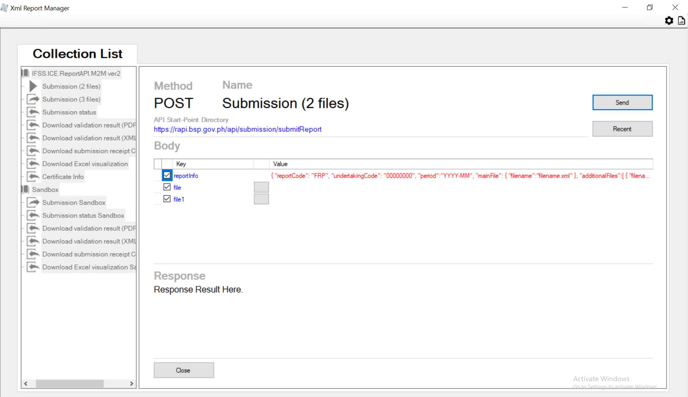
User Interfaces, Usability and Accessibility (5/5)

Slide 10
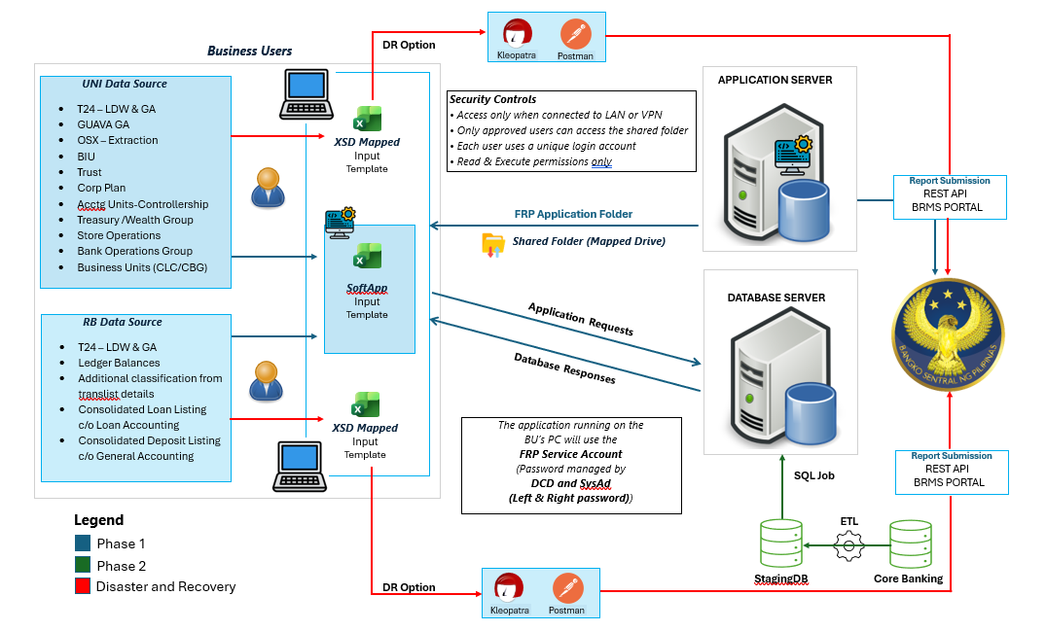
System Interfaces

Slide 11
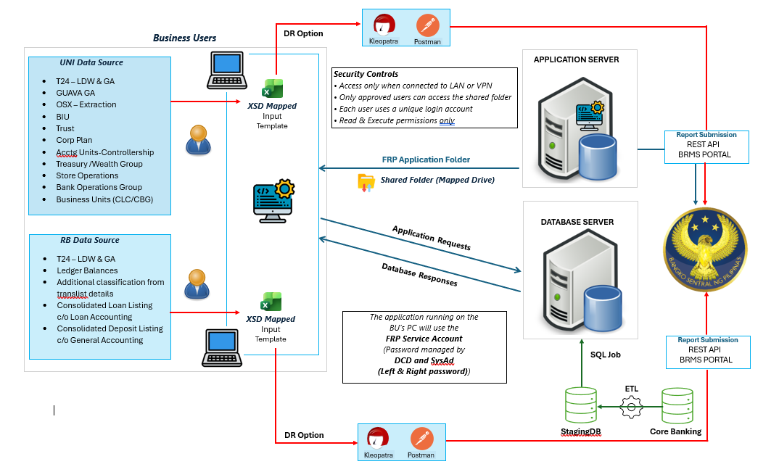
System Interfaces – Phase 2

Slide 12
Infrastructure and Technology Stack (1/3)
Description | : | DB server specifications
Software | Description(s)
Operating System | Windows Server 2022
Database | Microsoft SQL Server 2022
Hardware | Description(s)
CPU | Intel Xeon Gold 5412U (12 cores / 24 threads, 4.1 GHz Turbo)
RAM (in GB) | 128GB DDR5 ECC RDIMM or Higher for better performance
Data Storage (in GB) | 2 TB NVMe SSD

Slide 13
Infrastructure and Technology Stack (2/3)
Description | : | Application/Terminal server specifications
Software | Description(s)
Operating System | Windows Server 2022
Microsoft Office | Microsoft Office 365 (64bit)
Framework | .NET framework 4.8 or Higher
Hardware | Description(s)
CPU | Intel Xeon Gold 5412U (12 cores / 24 threads, 4.1 GHz Turbo)
RAM (in GB) | 128GB DDR5 ECC RDIMM or Higher
Data Storage (in GB) | 100GB Fast SSDs at Minimum for Quick Load Times
System Storage (in MB) | 20MB at startup

Slide 14
Infrastructure and Technology Stack (3/3)
Description | : | Block storage/SAN archive capacity
Hardware | Description(s)
Data Storage (in GB) | 2 TB SSD

Slide 15
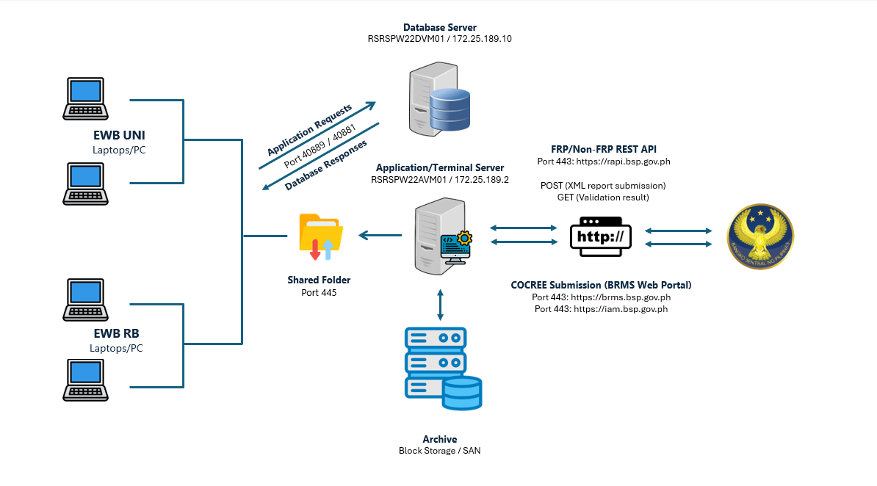
Network and Remote Access

Slide 16
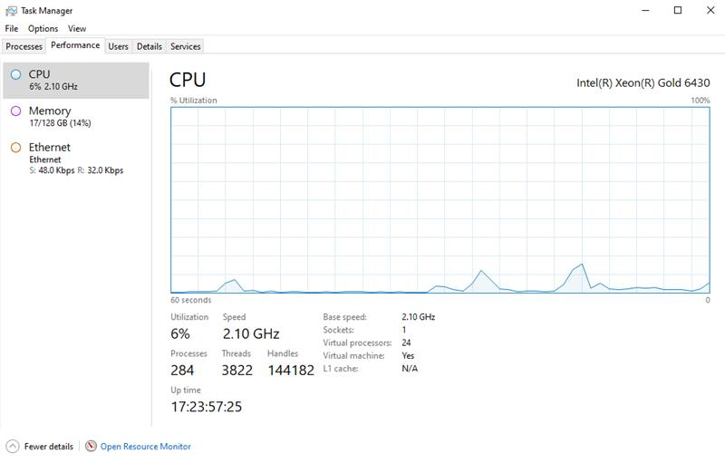
Capacity Plan (1/3)
Description | : | CPU utilization remain within acceptable levels after the implementation of the shared-folder setup.

Slide 17
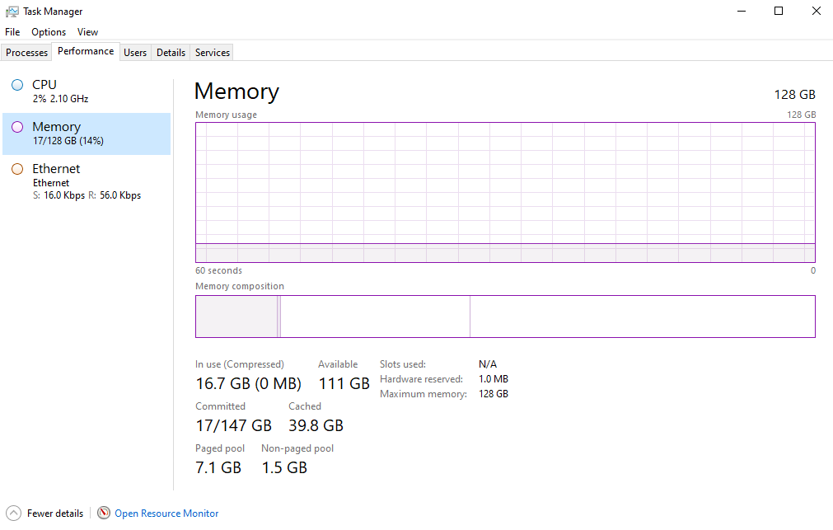
Capacity Plan (2/3)
Description | : | Memory utilization remain within acceptable levels after the implementation of the shared-folder setup.

Slide 18
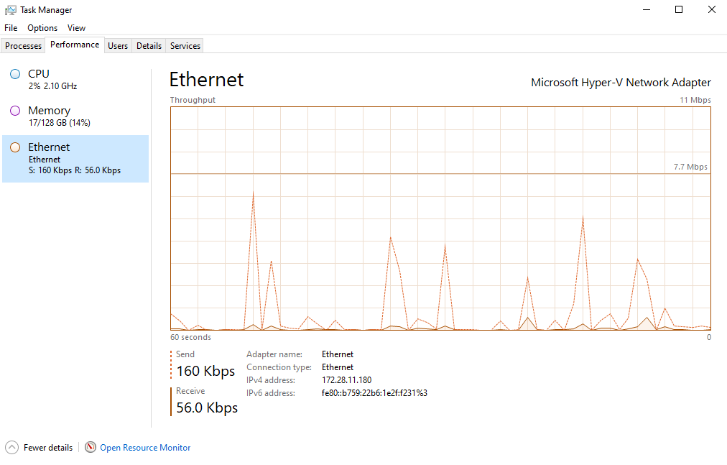
Capacity Plan (3/3)
Description | : | Ethernet/Network utilization remain within acceptable levels after the implementation of the shared-folder setup.

Slide 19
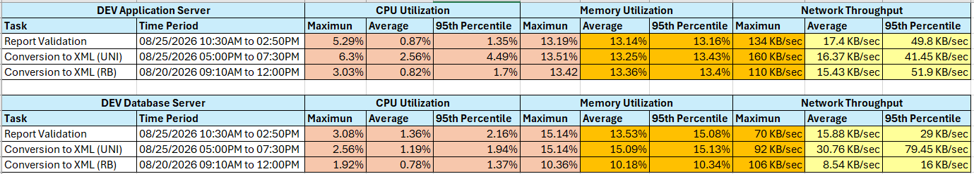
Performance and Reliability (1/4)
Performance | : | The server load from Site24x7 during simultaneous testing

Slide 20
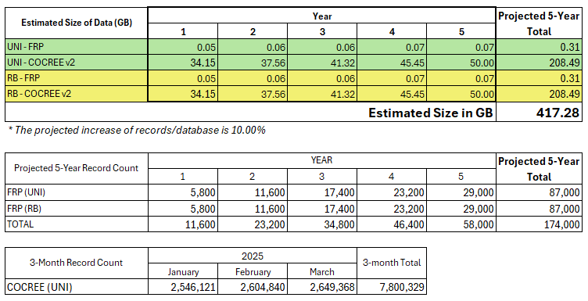
Performance and Reliability (2/4)
Size (Database) | : | Estimated size of the database Estimated number of inserted records of FRP and COCREE

Slide 21
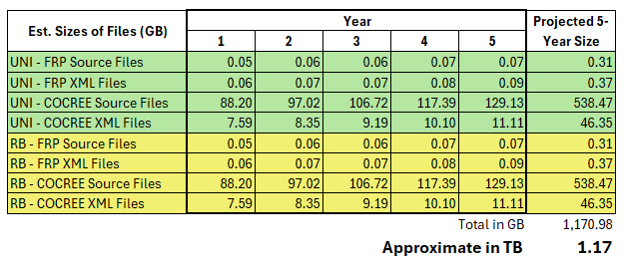
Performance and Reliability (3/4)
Size (Archive) | : | The projected five-year storage capacity for all the files needed by BU for archive is 1.17 TB (1,170.98 GB). Assuming 20% must be re-submitted and archived as well, the total storage required will be 1.4 TB.

Slide 22
Performance and Reliability (4/4)
Performance | : | The actual duration varies on the volume of data, but this can be mitigated by processing it in batches.
Reliability | : | The application's FRP version 15 is already being used by other banks. Version 16 is ready for deployment, but there is no target date for implementation from BSP. Regular server maintenance by applying patches, especially critical ones. The business unit has set a 5-year data retention period for both database records and files.

Slide 23
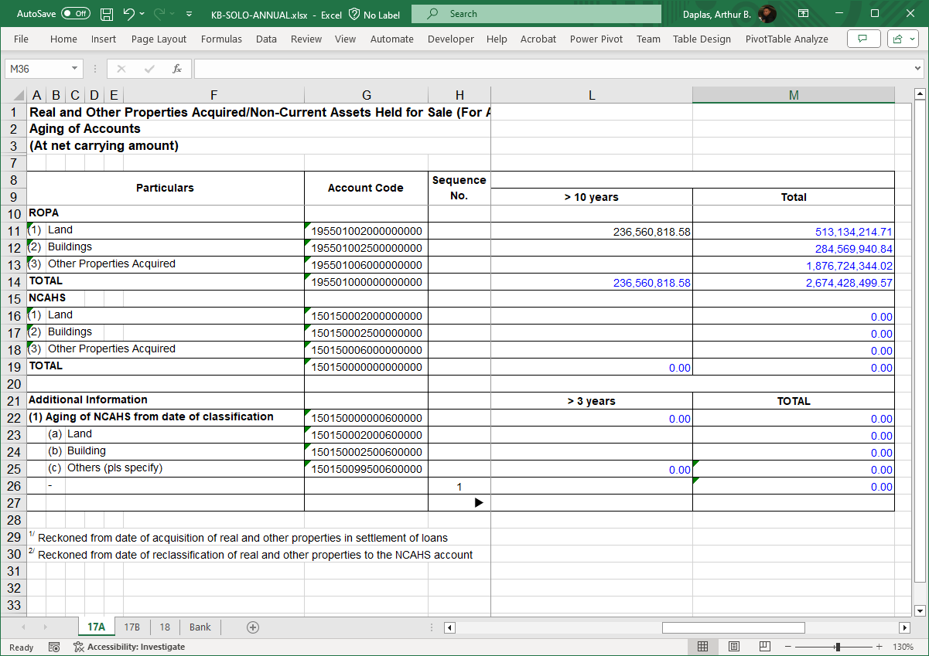
Data and Databases (1/5)
Description | : | Sample input template

Slide 24
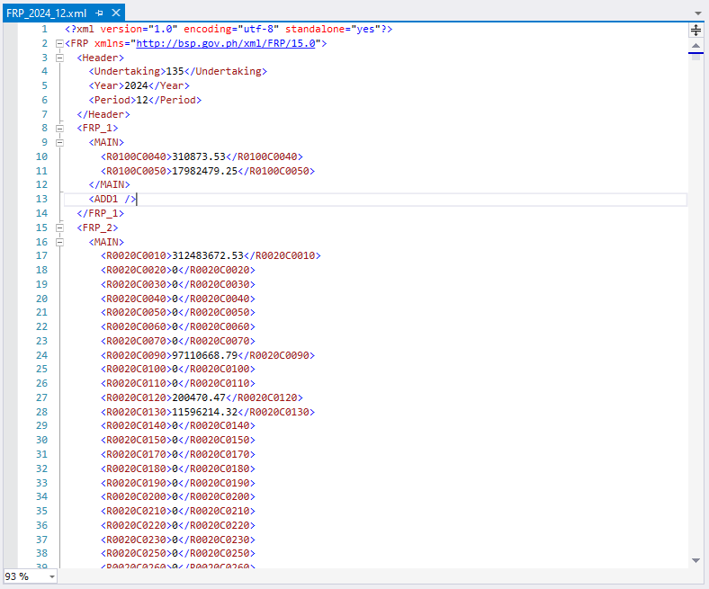
Data and Databases (2/5)
Details and Diagrams | : | Screenshot of the XML file to be sent to BSP

Slide 25
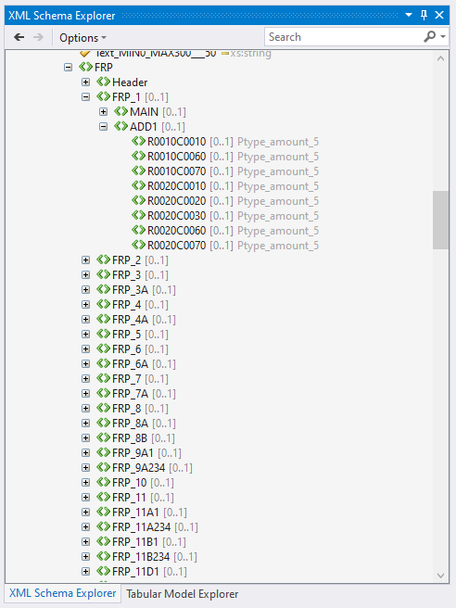
Data and Databases (3/5)
Description | : | Screenshot of the schema (XSD) from BSP

Slide 26
Data and Databases (4/5)
Description | : | The data types defined in the XSD.
FRP SOLO (1 of 2)
Name | Type | Remarks
Date___15 | date
Date___34 | date
Decimal_TD18_FD2_POS_Z___55 | date
Decimal_TD19_FD2_POS_Z___13 | decimal
Decimal_TD19_FD2_POS_Z___53 | decimal | Pattern \-?[0-9]{0,17}(\.[0-9]{0,2})?
Decimal_TD19_FD3___45 | decimal | Pattern \-?[0-9]{0,17}(\.[0-9]{0,3})?
Decimal_TD25_FD2___20 | decimal | Pattern \-?[0-9]{0,17}(\.[0-9]{0,2})?
Decimal_TD26_FD2___18 | decimal | Pattern \-?[0-9]{0,17}(\.[0-9]{0,2})?
DynamicDropdown_UNDERTAKINGVIEW_1___8 | string | Pattern [0-9]{0,4}
EnumList_ASSET_CLASS_11___31 | string | Enumerated List
EnumList_ASSET_TYPE_10___30 | string | Enumerated List
EnumList_BOOKCODE_123_2___1 | string | Enumerated List
EnumList_BOOKCODE_23_23___2 | string | Enumerated List
EnumList_BOOKING_DETAILS_17___37 | string | Enumerated List
EnumList_Borrower_Group_24___44 | string | Enumerated List
EnumList_CLASS_STOCK_3___16 | string | Enumerated List
EnumList_COUNTERPARTY_ISSUER_18___38 | string | Enumerated List
EnumList_COUNTERPARTY_SECTOR_19___39 | string | Enumerated List
EnumList_COUNTRY_13___27 | string | Enumerated List
EnumList_COUNTRY_OTHER_TERRITORIES_36___33 | string | Enumerated List
EnumList_CURRENCY_12___3 | string | Enumerated List
EnumList_CURRENCY_OTHER_16___6 | string | Enumerated List
EnumList_CURRENCY_OTHER_16___7 | string | Enumerated List
EnumList_CURRENCY_SNG_30___5 | string | Enumerated List
EnumList_groupsingle_49___48 | string | Enumerated List
EnumList_INDUSTRY_DESC_5___14 | string | Enumerated List
EnumList_MARKET_SEGMENT_14___35 | string | Enumerated List
EnumList_MARKETRISKAPPROACH_34___11 | string | Enumerated List
EnumList_MATPRESTAT_37___43 | string | Enumerated List
EnumList_OPERATIONALRISKAPPROACH_35___12 | string | Enumerated List
EnumList_RISK_WEIGHT_31___24 | string | Enumerated List
EnumList_SECURITIES_CLASS_22___42 | string | Enumerated List
EnumList_SECURITY_TYPE_20___40 | string | Enumerated List
EnumList_TRA_DETAIL_PURPOSE_15___36 | string | Enumerated List
EnumList_UITF_FUND_CLASS_9___29 | string | Enumerated List
EnumList_VOTING_IND_4___17 | string | Enumerated List
EnumList_YEARS_PREVIOUS_3_29___4 | string | Enumerated List
EnumList_YES_NO_21___41 | string | Enumerated List
FRP SOLO (2 of 2)
Name | Type | Remarks
Integer_TD10___23 | integer
Integer_TD10_POS_Z___22 | integer | Pattern [0-9]{0,9}
Integer_TD2_POS_NOZ___10 | integer | Pattern [0-9]{1,2}
Integer_TD2_POS_NOZ___52 | integer | Pattern \-?[0-9]{0,4}
Integer_TD4_POS_NOZ___51 | integer | Pattern [0-9]{0,4}
Integer_TD4_POS_NOZ___9 | integer
Integer_TD6_POS_NOZ___49 | integer
Percentage_TD10_FD2___25 | decimal
Percentage_TD10_FD2_POS_Z___28 | decimal
Percentage_TD10_FD6___19 | decimal
Percentage_TD11_FD2___26 | decimal
Percentage_TD12_FD6___21 | decimal
Percentage_TD9_FD2___32 | decimal
Ptype_amount_5 | decimal
Ptype_amount_pos_6 | decimal
Ptype_bgroup_members_20 | string
Ptype_branch_code_19 | string
Ptype_branch_code_dom_21 | string
Ptype_char10_22 | string
Ptype_char5_13 | string
Ptype_char50.1_26 | string | Pattern [^\s].*
Ptype_char50_11 | string
Ptype_char52_12 | string
Ptype_isin_17 | string | Pattern [A-Z0-9]*
Ptype_number_19_3_23 | decimal | Pattern \-?[0-9]{0,16}(\.[0-9]{0,3})?
Ptype_number_of15_4 | decimal | Pattern [0-9]{0,15}
Ptype_number_of6_3 | integer | Pattern [0-9]{0,6}
Ptype_number_of9_2 | integer | Pattern [0-9]{0,9}
Ptype_par_value_15 | decimal | Patterm \-?[0-9]{0,9}(\.[0-9]{0,4})?
Ptype_percent_8 | decimal | Pattern [0-9]{0,10}(\.[0-9]{0,6})?
Ptype_ratio_16 | decimal | Pattern \-?[0-9]{0,9}(\.[0-9]{0,5})?
Ptype_subsidiary_code_18 | string
Ptype_whole_number_9_27 | integer | Pattern [+-]?[0-9]{0,9}
Text_MIN0_MAX100___46 | string
Text_MIN0_MAX12___47 | string | Pattern [0-9]{12}
Text_MIN0_MAX300___50 | string
FRP CONSO
Name | Type | Remarks
Date___10 | date
Decimal_TD25_FD2___15 | decimal
Decimal_TD26_FD2___13 | decimal
DynamicDropdown_UNDERTAKINGVIEW_5___4 | string
EnumList_ASSET_CLASS_11___24 | string | Enumerated List.
EnumList_ASSET_TYPE_10___23 | string | Enumerated List.
EnumList_CLASS_STOCK_3___11 | string | Enumerated List.
EnumList_COUNTRY_13___20 | string | Enumerated List.
EnumList_CURRENCY_12___1 | string | Enumerated List.
EnumList_CURRENCY_OTHER_16___21 | string | Enumerated List.
EnumList_CURRENCY_SNG_30___3 | string | Enumerated List.
EnumList_INDUSTRY_DESC_5___9 | string | Enumerated List.
EnumList_MARKETRISKAPPROACH_34___7 | string | Enumerated List.
EnumList_OPERATIONALRISKAPPROACH_35___8 | string | Enumerated List.
EnumList_RISK_WEIGHT_31___17 | string | Enumerated List.
EnumList_VOTING_IND_4___12 | string | Enumerated List.
EnumList_YEARS_PREVIOUS_3_29___2 | string | Enumerated List.
Integer_TD4_POS_NOZ___5 | integer | Pattern [0-9]{0,4}
Integer_TD2_POS_NOZ___6 | integer
Percentage_TD10_FD2___18 | decimal
Percentage_TD10_FD2_POS_Z___22 | decimal
Percentage_TD10_FD6___14 | decimal
Percentage_TD11_FD2___19 | decimal
Percentage_TD12_FD6___16 | decimal
Percentage_TD9_FD2___25 | decimal
Ptype_amount_5 | decimal
Ptype_amount_pos_6 | decimal
Ptype_char10_22 | string
Ptype_char5_13 | string
Ptype_char50.1_26 | string
Ptype_char50_11 | string
Ptype_isin_17 | string
Ptype_number_19_3_23 | decimal | Pattern \-?[0-9]{0,16}(\.[0-9]{0,3})?
Ptype_number_of15_4 | decimal | Pattern [0-9]{0,15}
Ptype_number_of9_2 | integer | Pattern [0-9]{0,9}
Ptype_par_value_15 | decimal | Pattern \-?[0-9]{0,9}(\.[0-9]{0,4})?
Ptype_percent_8 | decimal | Pattern [0-9]{0,10}(\.[0-9]{0,6})?
Ptype_ratio_16 | decimal | Pattern \-?[0-9]{0,9}(\.[0-9]{0,5})?

Slide 27
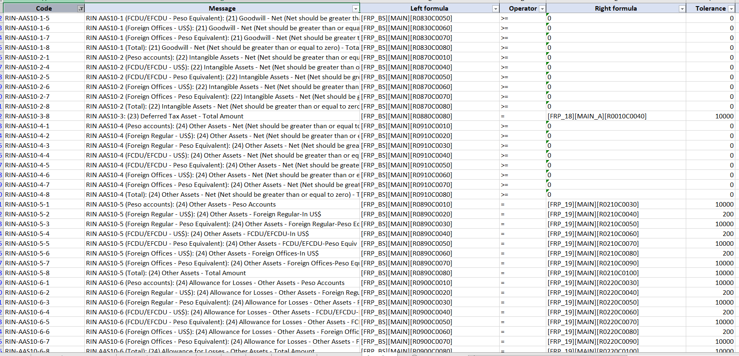
Data and Databases (5/5)
Description | : | Sample of validation rules (assertions) provided by BSP.

Slide 28
Reporting and Processes
Description | : | The application is designed to process and validate the following BSP reports (A-E):
A. Annex A - SOLO | B. Annex B- SOLO | C. Annex B - CONSO | D. Annex A – CONSO | E. Other Reports | Admin Reports | Internal Reports
SOLO-SOCSIE (M) | RCBP (M) | PBS-CONSO (Q) | CONSO-SOCSIE (Q) | CDRC (W, M) | Log Account Reports | Working Papers
SOLO-BORROW (M) | PBS-SOLO (PPBS included) (Q) | ERREE-CONSO (Q) | CONSO-BORROW (Q) | AFRD (Q) | Matrix Reports | Import Registry
SOLO-CNTNGNT (M) | ERREE-SOLO (Q) | LCR-CONSO (Q) | CONSO-CNTNGNT (Q) | COCREE (M) | Task Reports | Process Registry
SOLO-COCE (M) | LCR-SOLO (Q) | CARBASEL3-CONSO (Q) | CONSO-COCE (Q) | ITRS (W, M) | Log Trail Reports
SOLO-DEPLIAB (M) | MSME (Q) | BLR-CONSO (Q) | CONSO-DEPLIAB (Q)
SOLO-FINASSET (M) | CARBASEL3-SOLO (Q) | NSFR-CONSO (Q) | CONSO-FINASSET (Q)
SOLO-FINLIAB (M) | MRS (Q) | LEX-CONSO (Q) | CONSO-FINLIAB (Q)
SOLO-LOANS (M) | STRS-CREDIT (SA, A) | RPFE-CONSO (Q) | CONSO-LOANS (Q)
SOLO-NONFIN (M) | STRS-MARKET (SA, A) |  | CONSO-NONFIN (Q)
SOLO-OTHASSET (M) | EMI (Q) |  | CONSO-OTHASSET (Q)
SOLO-OTHLIAB (M) | BRIS (Q) |  | CONSO-OTHLIAB (Q)
SOLO-SIEACCT (Q) | BLR-SOLO (Q) |  | CONSO-SIEACCT (Q)
SOLO-ANNUAL (M) | NSFR-SOLO (Q) |  | CONSO-ANNUAL (Q)
 | REPO (M)
 | FRPTI (Q)
 | LEX-SOLO (Q)
 | RPFE-SOLO (Q)

Slide 29
Security
Details | : | The table below shows the security measures applied from the client connection to BSP submission.
Client PC Connection | Application and Database Servers | Submission to BSP
LDAP/AD integration | MBSS | Regulatory and Statutory Reports:
Restricted account (non-admin) | Trellix ENS | REST API URL whitelisting
IP Whitelisting | ATP | Secured by BSP issued certificate
Port Opening | Fireye
 | SIEM | COCREE:
 | Network firewall | Kleopatra encryption software
 |  | Public key provided by BSP
 |  | BRMS website portal whitelisting
Others:
VAPT (Rapid 7) c/o ISDPO
Configuration file encryption
TLS 1.2

Slide 30
Fault Management (1/2)
Scenario | Description | Remedy
Invalid import data | Invalid source data | Possible mismatch – check the registered columns with the source.
Failed import | An error is encountered while in the process of importing the data. | Re-upload. The previous imported data for the same reporting period will just be replaced. Just re-upload starting from the erroneous file onwards
Template validation failure | BU accidentally selected the wrong file to be validated. | The program will not accept a file with an incorrect template. The system runs a template validation as a first step.
 | Invalid bank code, reference period, invalid filename, and incorrect data type. | Specify the correct bank code, reference period, and follow the right filename format. Data types are also checked.
An error is thrown when opening the file | Unable to exclusively open the file for import. | Close the file after editing it, and before validating and converting it.
Data validation failure/unbalanced | There are validation errors returned by the application. | Correct the amounts/balances.
Failed report processing | An error is encountered during report processing of working paper, COCREE, and FRP reports. | The progress bar will indicate what schedule, sheet, item code is the error.
Conversion failure | Errors are encountered during XML conversion. | Check the sheets, You may have a missing parameter, an invalid date, and/or you may have selected an incorrect XSD that applies to the report. You may also check the working paper, that will be created with the XML file, for errors.
Incomplete report schedule | BSP expects a complete list of monthly, quarterly, semi-annual, and annual reports. | The system will generate a report after converting the input files to XML. It will display the reports that are missing for the reporting period.

Slide 31
Fault Management (2/2)
Scenario | Description | Remedy
Failed to submit | Error during XML file uploading to BSP. | Will not generate a token. The token will be used to check the status of the submitted XML report, which in effect is the proof of successful submission. Repeat the upload.
 | BSP Rest API or BRMS portal is down. | Need to inform BSP immediately because there are no alternative channels to submit the report. BU has tried to send it to the BSP assigned account officer but was redirected to the REST API and BRMS links.
Expired Certificates | Fail to establish connection to BSP due to an expired certificate. | BSP will send a notification, one month before the certificate expires, but BU needs to monitor the certificate's expiration date, just in case. Only BU is allowed to request for a renewal, and a CR ticket will be needed to deploy the new certificate to the production server. Meanwhile, the public key for Kleopatra does not expire.
GA is inaccessible | GA is down or the user is having trouble logging in. | Need to file an SR ticket to fix BU's access to GA. If urgent, file an SR to transfer the files to the application server.
The server is inaccessible via RDC | Can't connect to the application server via Remote Desktop Connection | Contact IT and file an SR ticket.
Database is not accessible | A connection error is being thrown by the application when they try to process a report. | Contact IT and file an SR ticket.

Slide 32
User Access Matrix and Parameters
Category | Type | Task | Module
Admin | Maker | User Profile Management | Log Account Maintenance
 |  | User Attribute Settings | Matrix Maintenance
 | Checker | Task Validator | Task Module
 | All | Trail Report | Trail Module
Category | Type | Task | Module
Business | Maker | Upload/Import Data | Import (Temp Transfer)
 |  | Set Mapping Criteria | Report/Mapping Form (Set Entries)
 |  | Data Maintenance Entry Settings | Report/Parameter Form (Set Entries)
 |  | Process Schedule Template/Reports | Report (Process/Preview)
 | Checker | Validate Uploaded Data | Import (Final Transfer)
 |  | Check Map Criteria Entries | Report/Mapping Form (Validate Entries)
 |  | Verify Data Maintenance Values | Report/Parameter Form (Validate Entries)
 |  | Produce Schedule Template/Reports | Report (Process/Preview/SaveAs)

Slide 33
Scalability, Resilience and Disaster Recovery
Scalability | : | New reports and validation rules can be added in the future. Additional user accounts may be purchased later.
Resilience | : | Regular backup of: Files Database Server backup or image
Disaster Recovery | : | Classified by the business unit as low priority, non-critical, in their BIA. They can revert to their manual (current) process to produce the XML report and submit.

Slide 34
Operational Requirements
Description | : | Post deployment support will be available to the business unit on the following level: First Level: Service Desk Second Level: Production Support, and SRAU for user access-related issues Third Level: GL Enterprise Team Fourth Level: SoftApp Team Other teams: DBA: maintenance and backup of the database. System Administrator: maintenance and image backup of the servers. Network: resolves network-related issues. Business Unit: Regular checking of updates from BSP. Purging of old archived files beyond the retention period. Maintaining the file naming conventions.

Slide 35
Other Design Details
Testing Type | Responsible Unit
 | SoftApp | EWB - BU | EWB - ITG
Unit Testing | ✓
Smoke Testing | ✓
System Testing (end-to-end) | ✓
UAT |  | ✓
PIR and Sanity Testing |  | ✓
VAPT |  |  | ✓
Testing Approach | :
Deployment Approach | : | Development related to mapping, templates, and validation rules UAT Creation of deployment scripts and documents CAB Server preparation and hardening Firewall whitelisting, port opening, service account configuration Database and application deployment to production environment
Special Design Considerations | : | None

